Slide 1
Social Network Analysis
Structural Aspect

Slide 2
Introduction
In the domain of Social Network analysis broadly there are two categories of study
Evolution and Structure: How the network evolved and modelling its structure and comparing against real-world data.
Behavior and Dynamics: Studying the interaction of various nodes and their inter-dependence and the influence of their behavior on other nodes and the evolution of the network as a whole.
In this presentation we will go through the structural aspects and see some of the models used in Social Network Analysis and their characteristics,merits and demerits.

Slide 3
Points
Three levels of structure:
Micro: Related to individuals
Meso: Related to a sizeable population.
Macro: Studies the outcomes of economic and other resource transfer interactions with large populations.

Slide 4
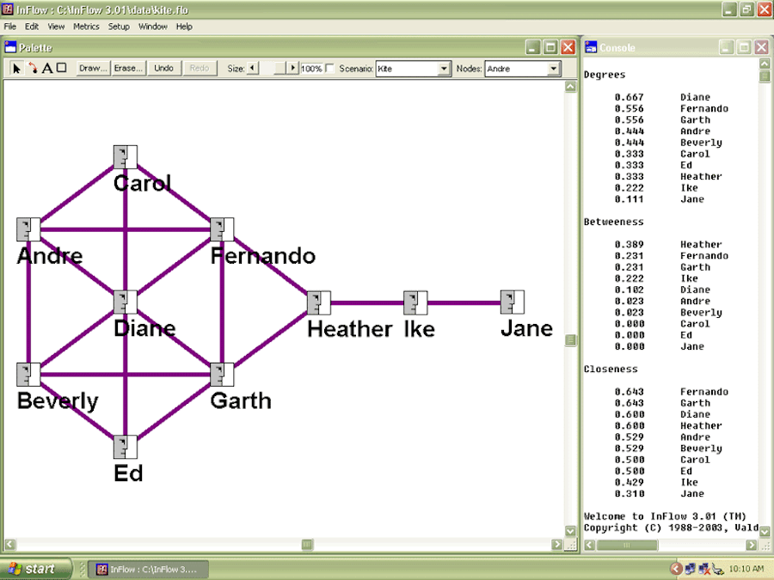
Some Useful Terminology explained via an example
Centrality: The most important points in a graph.
Degree centrality: Diane
Betweenness centrality(decides the outcome): Heather
Closeness centrality: Fernando and Garth(shortest path to other nodes)

Slide 5
Bowtie Model Of Web Graph

Slide 6
Detour - The Web Graph
Before we get into models used in a generic sense, let us see a specific model analysis of one of important networks - The Web.
The Web is modelled as a network where each node is a web page and its a directed network where each edge A->B denotes a hyperlink from page A to page B.

Slide 7
Terminology
A couple of things we will be using in this model and the other models.
SCC - Strongly Connected Component.
WCC - Weakly Connected Component i.e the connected component after converting to undirected graph.
In(V) - It is the set of node from which there exists a path to the set V.
Out(V) - The set of nodes reachable from the nodes in set V.

Slide 8
Web Graph - The Structure
This is not a model which is proposed and then tested with stats and properties against real data like most of the other models.
Rather, the web data was crawled in 2000 by Andrei Border and others and the characteristics were then analysed and the network was modelled.
It was found that there was a single large SCC- This is an important feature of not only this model but also most of the global models.
It was also seen that the rest of the graph was divided into In(SCC) and Out(SCC) and the leftover portions result in only 1/4th of the nodes.

Slide 9
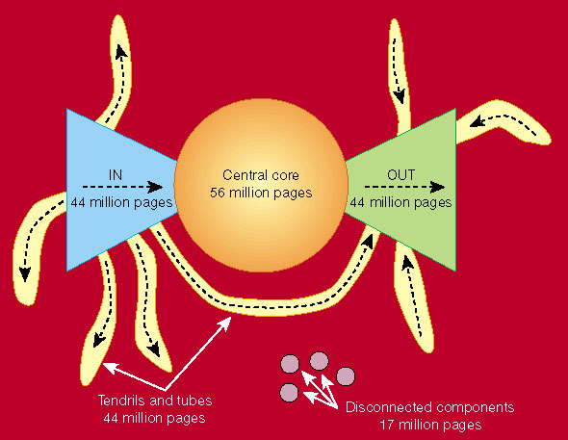
Bowtie Model of Web as in 1999-2000

Slide 10
Web Graph - Evolution
The web Graph was again analysed in 2012.
It retained the Bowtie structure but it is no longer even and ended up as a skewed Bowtie with a larger In component than the Out component.
And the tendrils and tubes have become practically negligible in the graph.
The size of giant component has increased occupying 50% of the graph from the earlier 38%.

Slide 11
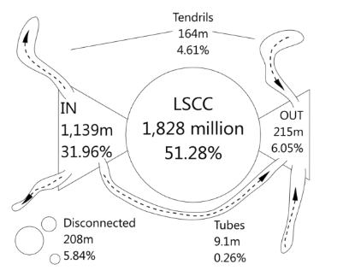
Bowtie as in 2012

Slide 12
Bowtie - Final Words
The comparison says how dynamic the networks are and how they keep changing.
The number of nodes have increased a lot as expected.
The average degree of the network has increased about 5 times.
The Giant component has increased in size, indicating increasing connectedness.
Negligible percentage of tendrils also indicates that only a few pages are isolated.
This gives us an idea that web will evolve in future by increasing the Giant component further and the tendrils and tubes will decrease to join Giant component or In(SCC) or Out(SCC).

Slide 13
Erdos-Renyi Random Model

Slide 14
Introduction
This is random model as the name suggest and is proposed by Erdos and Renyi in 1960 .
One of the oldest models to be proposed in Graph theory.
The graph G_{n,p} has two input parameters n,p
n - The number of nodes present in the graph.
p - The independent probability of existence of each edge in the graph.

Slide 15
Random Model
For a given n,p also we can get a variety of graphs.
We generate the graph each time by probability ‘p’ of existing for each of the ^{n}C₂ possible edges.
The Model is tested against real world data along the following parameters
Degree Distribution - It is a histogram of the P(deg=k) versus degree.
Path Length - The average of min path length between nodes (i,j).
Clustering Coefficient - A measure of how much the neighbours of a node are connected intern to each other.

Slide 16
Random Model - Degree Distribution
P(deg=k) = ^{n-1}C_{k}*p^{k}(1-p)^{n-1-k}
The Distribution turns out to be a binomial distribution.
The average degree is also the expectation over the degree distribution.
Average degree = E(deg=k) = Σ(^{n-1}C_{k}*p^{k}(1-p)^{n-1-k})*k
It turns out to be equal to (n-1)*p

Slide 17
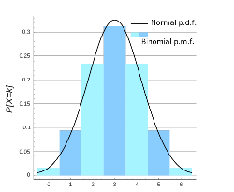
Degree Distribution

Slide 18
Random Graph - Clustering Coefficient
Clustering coefficient is an indicator of how many of the current node’s neighbours are connected to each other.
C_{i} = 2*e_{i} / k_{i}*(k_{i} -1)
e_{i} - The number of edges among the neighbours of current node.
k_{i} - The degree of current node.
e_{i} = p*k_{i}*(k_{i}-1)/2 as each edge has independent probability of p.
So, the C_{i} turns out to be p.
Average Deg = (n-1)*p so p can be approximated as Average Degree/(n).
Clustering Coefficient = p ∼ Average Degree/n

Slide 19
Random Graph - Average path
The average of shortest path length is found to be of the order of log n
The derivation is complex and time-taking hence it is not mentioned here.
Path Length = O(log n)

Slide 20
Comparision
Once we got these three parameters for the Random, we are left with analysing as to how much this model is close to the Social Network.
MSN messenger data was crawled for about a month by Jure Leskovec ,former Microsoft employee and currently professor at Stanford.
The various parameters and features of the network were observed.

Slide 21
Comparision
The Real Data and Model were in terms with each other along
Giant Component - Both of them have a large giant component containing a vast majority of nodes.
Path length - The random graph model correctly estimates the average shortest path length between any two nodes.
The Real Data and Model were different for the following
Degree Distribution - The degrees distributions were strikingly different. Random has a very symmetric one whereas real world one is hyperbolic on log-log plot.
Clustering Coefficient - Both the values differ by a lot.

Slide 22
Random Graph - Conclusion
All in all Random Model is not a perfect way to model the Social Network.
Even Semantically, it can't be supported as the links in the Social Network are not formed randomly.
But , the random network model has some features in common to the Social and can be used for analysing the randomness of any feature of the real data i.e to what extent it is close to a random process.

Slide 23
SCALE-FREE Networks
A scale-free network is a network whose degree distribution follows a Power law.
POWER LAW:
A relative change in one quantity results in a proportional relative change in the other quantity, independent of the initial size of those quantities: one quantity varies as a POWER of another. For instance, considering the area of a square in terms of the length of its side, if the length is doubled, the area is multiplied by a factor of four.
P(k) of nodes in the network having k connections to other nodes goes for large values of k as

Slide 24
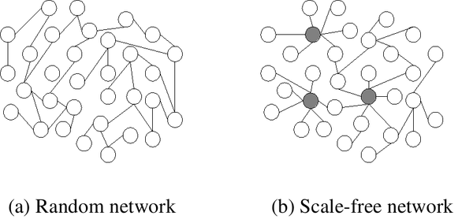
Characteristics of Scale-Free Networks
Hubs. The relative commonness of vertices with a degree that greatly exceeds the average.

Slide 25
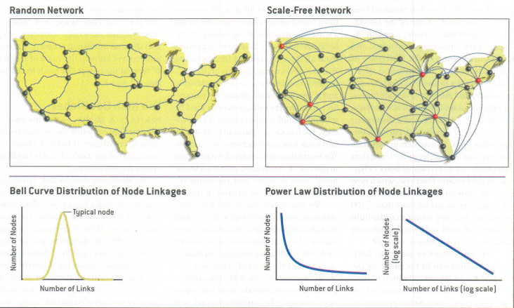
Highway vs Airline Network

Slide 26
Characteristics of Scale-Free Networks
ROBUSTNESS TO FAILURE
Hierarchy: Major hubs followed by smaller, and yet smaller ones, allows for fault-tolerant behaviour.
Random failure: The likelihood that a hub would be affected is almost negligible. Hub-failure: The network will generally not lose its connectedness, due to the remaining hubs. On the other hand, if we choose a few major hubs and take them out of the network, the network is turned into a set of rather isolated graphs.

Slide 27
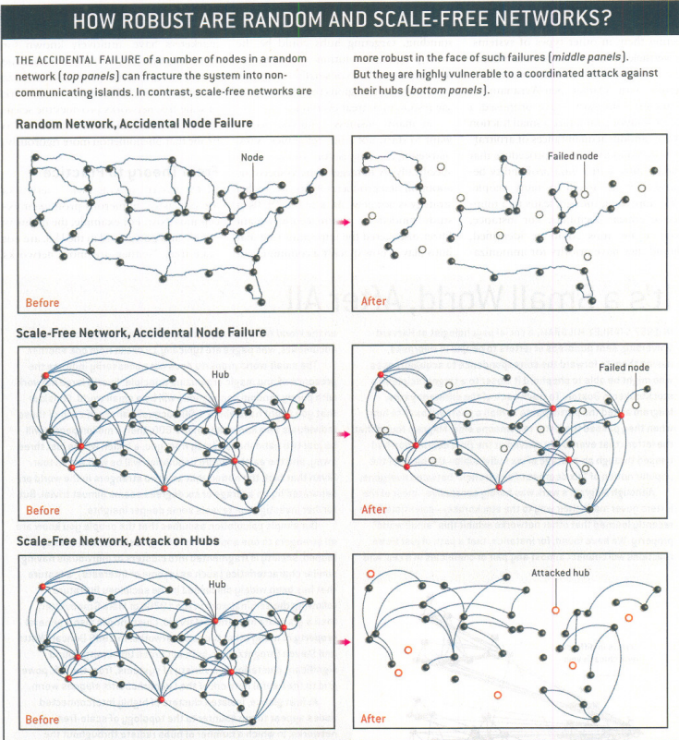

Slide 28
Characteristics of Scale-Free Networks
ROBUSTNESS TO FAILURE
It was proven by Cohen that for a broad range of scale free networks the critical percolation threshold, pc=0.
This means the removing randomly any fraction of nodes from scale network will not destroy the network.
This is in contrast to Erdos Renyi graph where pc =1/<k>, where <k> is the average degree.
Ref: Cohen, Reuven; Erez, Keren; ben-Avraham, Daniel; Havlin, Shlomo (2000). "Resilience of the Internet to Random Breakdowns". Physical Review Letters.

Slide 29
CLUSTERING CO-EFFICIENT
A clustering coefficient is a measure of the degree to which nodes in a graph tend to cluster together.
# Global cc: Given below.
# Local cc: The local clustering coefficient of a vertex (node) in a graph quantifies how close its neighbours are to being a clique (complete graph).
Formula: LCC =( 2 * N ) / K(K-1).
Where K is the degree of the node , N is the no. if links b/w immediate neighbours of that node.

Slide 30
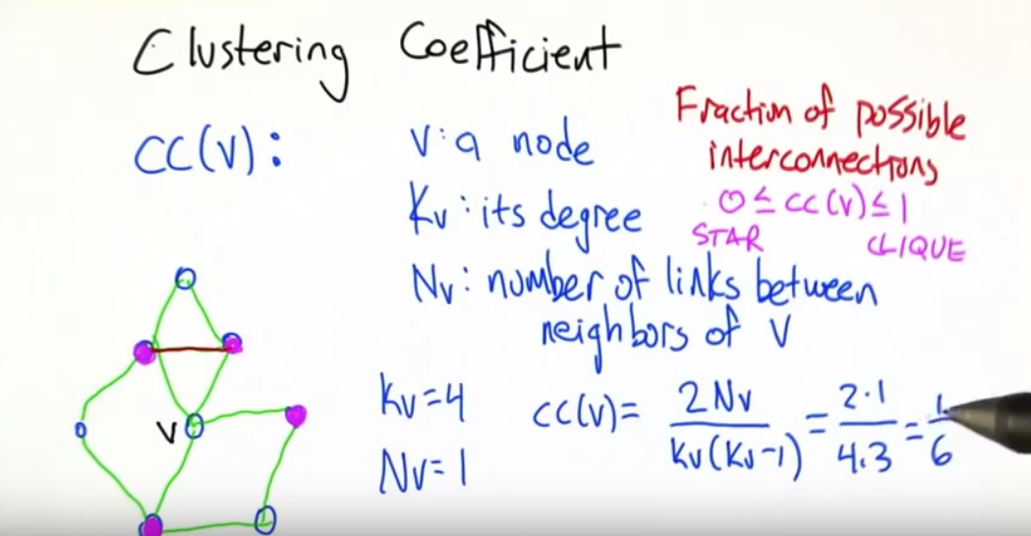
CLUSTERING CO-EFFICIENT
CC=( 2 * N ) / K (K-1).
Denotes how close its Neighbors are to being a clique.

Slide 31
Characteristics of Scale Free Networks
-Clustering coeff. distribution decreases as the node degree increases. This distribution also follows a power law.
-This implies that the low-degree nodes belong to very dense sub-graphs and those sub-graphs are connected to each other through hubs.
EXAMPLE: People around us. Consider a social network in which nodes are people and links are acquaintance relationships between people. It is easy to see that people tend to form communities, i.e., small groups in which everyone knows everyone. In addition, the members of a community also have a few acquaintance relationships to people outside that community. Some people, however, are connected to a large number of communities (e.g., celebrities, politicians). Those people may be considered the hubs .

Slide 32
Characteristics of Scale Free Networks
GENERATIVE MECHANISM:
For preferential-attachment networks, typically: HIGH DEGREE VERTICES IN THE MIDDLE OF THE NETWORK.
Advantage: The random removal of even a large fraction of vertices impacts the overall connectedness of the network very little, suggesting that such topologies could be useful for security, while targeted attacks destroys the connectedness very quickly.
Other scale-free networks, which place the high-degree vertices at the periphery, do not exhibit these properties.

Slide 33
Characteristics of Scale-Free Networks
Social networks, including collaboration networks.
Many kinds of computer networks, including the internet and the webgraph(directed links b/w pages) of the WWW.
Some financial networks such as interbank payment networks.
Protein-protein interaction networks.
Semantic networks.
Airline networks.

Slide 34
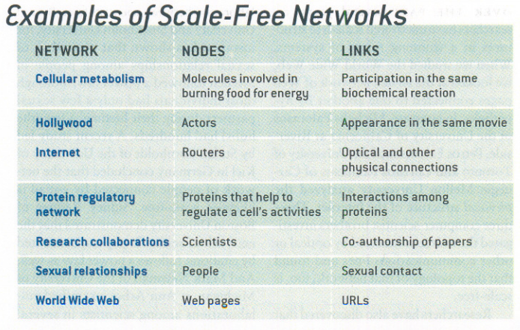

Slide 35
How to generate Scale-Free Networks?
-Different process from random Erdos-Renyi graphs.
- Most widely known generative model for a subset of scale-free networks is Barabasi and Albert's (1999) rich get richer generative model.
-We will discuss Barabasi Albert model in the coming slides.

Slide 36
Barabasi-Albert Model
The network contains few nodes (called hubs) with unusually high degree as compared to the other nodes of the network.
BA model tries to explain existence of such nodes in real networks.
Each new Web page creates links to existing Web pages with a probability distribution which is not uniform(which happens with prob. P in random Erdos-Renyi), but proportional to the current in-degree of Web pages.

Slide 37
Barabasi-Albert Model
2 MAJOR PROPERTIES:
Growth.
Preferential Attachment.
Preferential attachment: It refers to any class of processes in which resources(edges, wealth) etc. are distributed based on what they already have.
As we previously mentioned, each new Web page creates links to existing Web pages with a probability distribution which is proportional to the current in-degree of Web pages.

Slide 38

Barabasi-Albert Model
Algorithm:
The network begins with an initial connected network of m₀ nodes.
New nodes are added to the network one at a time. Each new node is connected to m < m₀ existing nodes with a probability that is proportional to the number of links that the existing nodes already have.
i.e . the probability P that a new node connects to node ‘i’ in the network is:
Where k is the degree of i, and the denominator is the total degree of the graph(2*no. of edges).

Slide 39
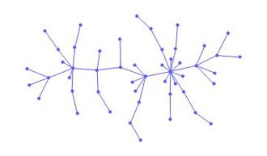
Barabasi-Albert Model
Heavily linked nodes ("hubs") tend to quickly accumulate even more links, while nodes with only a few links are unlikely to be chosen as the destination for a new link. The new nodes have a "preference" to attach themselves to the already heavily linked nodes.
A network generated according to the Barabasi Albert model.
The network is made of 50 vertices with initial degrees m₀ = 1.

Slide 40
Barabasi-Albert Model
M₀ = 2.
See the GIF of how it works in practice.
-Degree distribution for BA model:

Slide 41
Other Models to generate Scale-Free Networks
The copy model in which new nodes choose an existent node at random and copy a fraction of the links of the existent node. This also generates a power law.
Two-level network model
Mediation-driven attachment (MDA) model
Non-linear preferential attachment

Slide 42
SCALE-FREE NETWORKS
INTERNET:
A common property of many large networks, including the Internet, is that the connectivity of the various nodes follows a scale-free power-law distribution, P(k) = c k^{-a} . We study the stability of such networks with respect to crashes, such as random removal of sites.
For the critical fraction of nodes, pc , that needs to be removed beforethe network disintegrates.
For a <= 3, this disintegration takes place, unless the network is finite. In the special case of the physical structure of the Internet
!a # 2.5", we find that it is impressively robust, with p c . 0.99.

Slide 43
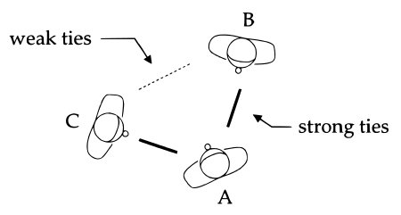
SOCIAL NETWORK TIES
WEAK TIE HYPOTHESIS: The "weak tie hypothesis" argues that if A is linked to both B and C, then there is a greater-than-chance probability that B and C are linked to each other.

Slide 44
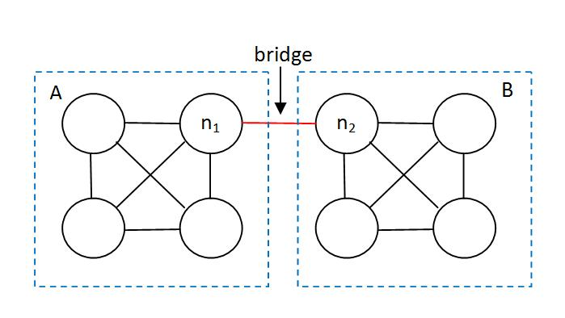
NETWORK BRIDGES
A direct tie between nodes that would otherwise be in disconnected components of the graph.

Slide 45
NETWORK BRIDGES
In social networks, bridges transmit information from one group to another.
Bridges are powerful ways to convey awareness of new things, but they are weak at transmitting behaviors that are in some way risky or costly to adopt.
Weak ties are able to spread awareness of a joke or an online video with remarkable speed, but political mobilization moves more sluggishly, needing to gain momentum within neighborhoods and small communities.

Slide 46
Small World Model

Slide 47
Build Up - The Small World Phenomenon
We all are familiar with the 6 degrees of separation - i.e you can reach any other person on the Social Network within 6 hops of acquaintances.
Not only in the acquaintance network , even in the citation network and also acting networks, we have evidence pointing to very short paths.
Kevin Bacon number is measured as the distance of actors from Kevin Bacon in the actor-collaboration graph where two actors are connected if they appear in a movie.
The average Kevin Bacon number is 2.9 and the highest found number is 8.
Analogous to this in the field of Science we have Erdos number for researchers.

Slide 48
Small World - An interesting experiment
The roots to this model and this school of thought date back to 1960’s when a Social researcher called Milgram carried out an interesting experiment.
In the experiment he selected a stockbroker in Boston as the target and sent posts to random people across US and asked them to forward the post to their acquaintances who might be knowing the target.
Only 64 chains were completed and out of them the average path was found to be 6.6 hops.
This is not solid enough to conclude the six degrees of separation as it is a single target and a very small sample space.

Slide 49
Small World
Later the experiments were carried out on emails and on the online network data.
Surprisingly, the average path length was around 4.5-6.5 in various experiments.
But is 6 hops as close as it appears???
Although Small World phenomenon is not an indicator of closeness/personal contact, rather it tells us about how fast disease/information/any other signal passes through the network.

Slide 50
Small World Model - Introduction
The model is based on the intuitions got from the above and real data
The network should have short path lengths.
The network should have high clustering.
But the models existing till then had high clustering and high diameter or low clustering and low diameter but not a cross combination.

Slide 51
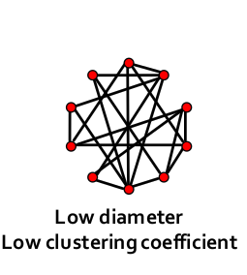
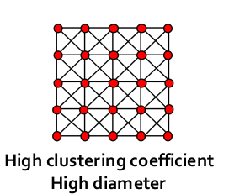
Two Classic Examples
Organised lattice leads to high-high scenario.
Randomised graph leads to low-low scenario.

Slide 52
Analysis of the two networks
Lattice
In this all the neighbours of nodes are connected and has high clustering.
In this there are no long-range edges and hence high diameter.
Random Graph
In this we have a lot of long range edges comparatively as it is randomly generated and thereby the diameter is low.
And also since not many of neighbours are connected the clustering coefficient is low.

Slide 53
Small World Model - Overall Idea
Small World idea suggests us a graph with high clustering and low diameter as seen earlier.
To achieve that we make a hybrid of both the models we discussed today.
We start off with a regular lattice and introduce randomness with a low probability to an extent such that the clustering constant does not fall a lot,but we have decent amount of long-range edges to decrease diameter.

Slide 54
Small World Model
The Small World mode is also called Watts-Strogatz model in the credit of the two people who designed it.
The steps involved are
Start with a regular lattice which of course has high-high characteristic.
Then tweak each edge with a probability p and shift one of its ends to a random node.
Select p such that shortcuts are made for decreasing diameter but clustering remains high.
Alternatively with p you can also add random edges rather than tweaking existing ones.

Slide 55
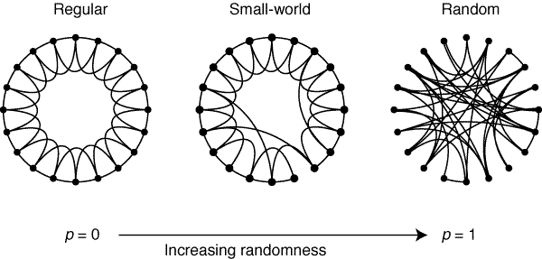

Slide 56
Merits Demerits
Merits
It models based on real data input.
Hence it is very close to most of the real networks.
Demerits
Although average shortest path is O(log n) it doesn’t favour for searches in O(log n) and hence becomes expensive for search and navigation.

Slide 57
Ego Networks

Slide 58
Introduction
Ego networks combine the ideas of mainstream Social Sciences and Network analysis.
Most of the models in Social Network Analysis are global i.e they model the network as a whole and analyse the properties of the network.
They treat all the nodes equivalently.
But in Ego Networks , each user has his own Ego Network which has a lot of information of his position,power,influence.
A large and single network can be made by mixing all the Ego Nets without compromising the properties.

Slide 59
Ego Net
Each Ego Net has a focal node called ‘Ego’.
Its immediate neighbours are the other nodes present in the graph also called as ‘Alters’.
The Ego Network has edges from Ego to all Alters and optionally among the alters too.

Slide 60
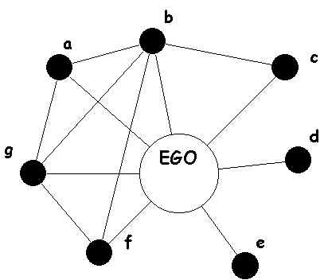
Ego Net

Slide 61
Ego Net - Data Collection
This is the most important and tedious part of Ego Networks.
Each person has to be asked a set of questionnaire which is uniquely designed for specific applications.
Each person is asked about
Alters/his immediate ties
Their attributes like age,Income,gender etc.
The Ego’s relation with alters
Additionally , the ties among alters are also asked.

Slide 62
Ego Net - Network Analysis
Each Ego net is only as large as the degree of Ego node.
Each individual Ego Net is analysed along following lines
Composition - The variety in the alters based on the attributes.
Homophily - Correlating the attributes of Ego and his alters and seeing how similar are Ego’s acquaintances to him.
The overall network can be generated but is not of much significance.

Slide 63
Ego Net - Structural Holes
This is an important theory started by Ronald Stuart Burt.
Basically, this theory analyses the power, access to information and all in all monopoly enjoyed by the Ego purely based on the structure of the network.

Slide 64
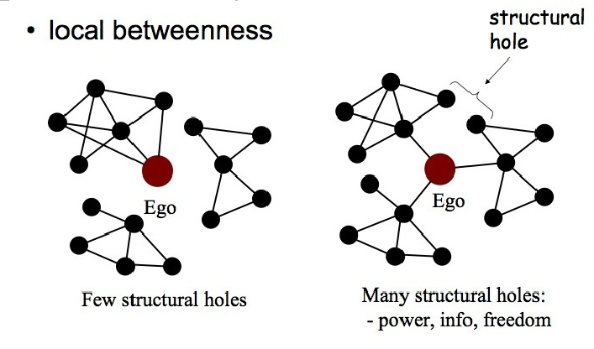

Slide 65
Ego Net - Structural Holes
As we have seen in the earlier picture, if the Ego forms a bridge between two or more components or nodes, he is clearly in a powerful position.
He has access to information from all of them.
He also has authority in the network as he is the only way to reach from one component to another.
In this way, compared to the graph on the left , the Ego on the right side network has a lot of power and freedom.

Slide 66
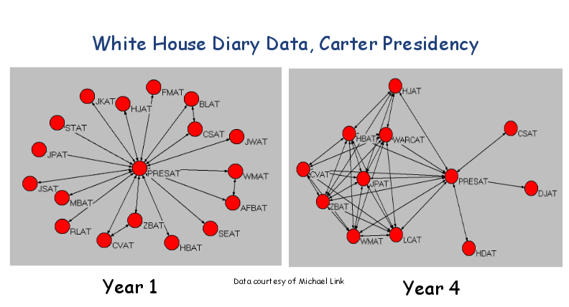
Example of Power Analysis

Slide 67
Example Of Power Analysis
Jimmy Carter was one of the presidents of US.
The picture shows us how he was the complete boss of White House in his first year at office.
This is because his alters have barely any links among themselves.
But over the four years this was not the scenarios ties among alters have increased drastically and an alternate power-center started rising showing that he was not that powerful in his last year.

Slide 68
Structural Holes - Measuring Intensities
The ways for mathematically measuring intensity of structural holes is as follows
Effective Size - It is defined as (n - 2*t/n) where n is the number of alters and t is the number of ties between alters.
Efficiency - It is the ratio of the Effective size to the total number of alters.
Effective size and efficiency are directly proportional to the Power and freedom of the Ego.

Slide 69
Ego Nets - Final Remarks
Merits
They study the network at a personal level and can extract information about relations and other personal things.
This model doesn’t need extraneous effort for Behaviour analysis as Ego’s behaviour can be adjudged from the Ego network.
Demerits
Not all nodes may give data required for constructing Ego net.

